Slide 1


CLICK-ON KADUNA
DATA SCIENCE FELLOWSHIP PROGRAMME
MODULE 7: EXPLORATORY DATA ANALYSIS WITH PYTHON

Slide 2
INTRODUCTION TO PYTHON DATA TYPES & STRUCTURES
INTERROGATING DATA
DATA EXPLORATION WITH PANDAS
EXPLORING NOISE VS BIAS WITH NUMPY
DATA VISUALIZATION WITH MATPLOTLIB & SEABORN
USING PYTHON TO PROCESS DHIS2 DATASET
COURSE OVERVIEW

Slide 3
SOFTWARE TOOLS
JUPYTER NOTEBOOK
VISUAL STUDIO CODE
GOOGLE COLABORATORY
Notes:
Follow the links below for installation guides
https://jupyter.org/install
https://www.anaconda.com/products/individual
https://colab.research.google.com/

Slide 4
SOFTWARE TOOLS FOR LEARNING
PYTHON PROGRAMMING
PANDAS
NUMPY
MATPLOTLIB
SEABORN

Slide 5
LESSON OUTCOMES
DATA IMPORTATION
DATA CLEANING
DATA SAMPLING
DATA ANALYSIS
DATA VISUALIZATION
CASE STUDIES AND PROJECTS

Slide 6
INTRODUCTION TO PYTHON DATA TYPES & STRUCTURES
DATA TYPES
NUMERICAL DATA: Discrete & Continuous
Discrete: 1,2,3,4,5
Continuous: Temperature Data, Weight Data
CATEGORICAL DATA: Qualitative e.g. Gender, Marital Status, Blood Type, Drug Types, etc
Variables that describe Categorical data are known as Categorical Variables
Categorical Variables are either Nominal, Ordinal, Ratio or Interval

Slide 7
TYPES OF CATEGORICAL VARIABLES
Binary Categorical Variable: Takes two values. E.g. Yes or No, Success or Failure, Positive or Failure..
Polytomous Variable: Takes more than two possible values. E.g. Marital Status; Married, Single, Seperated, Divorced. Response; Strongly Agree, Agree, Strongly Disagree, Disagree.

Slide 8
MEASUREMENT SCALES FOR CATEGORICAL VARIABLES
Nominal: Do not carry numerical importance. E.g. African, Caucasian, Hispanic, etc
Ordinal: Has numerical importance. E.g. Scale of success, Scale of importance, Pass mark, GPA’s
Ratio: Order, exact values & absolute zero
Interval: Measure of central tendencies. E.g. Mean, Median, Mode, Standard Deviations

Slide 9
DATA STRUCTURES
Data Structure provides a particular way of organizing data so it can be accessed efficiently.
Python ships with an extensive set of data structures in its standard library.
Notes:
https://realpython.com/python-data-structures/

Slide 10
TYPES OF DATA STRUCTURES
Dictionaries: They are central data structures. They store arbitrary number of objects, each identified by a unique dictionary key. {“Peter”: 08063431315}
Arrays: They are contiguous data structures. They consist of fixed data records that allow each element to be efficiently located based on it’s index. []
Notes:
https://realpython.com/python-data-structures/

Slide 11
3. List: A list allows elements to be added and removed within a square bracket. A list can hold arbitrary elements. Lists are mutable
4. Tuples: Tuples can hold arbitrary elements but unlike lists, they are immutable.

Slide 12
INTERROGATING DATA
This is a process of querying data for the purpose of investigating the data quality, relationships, anomalies, verifications, etc.
One crucial Data Interrogation Technique is Descriptive Summary Statistics.
Trying to make sense of the data collected.

Slide 13
IMPORTING DATA USING PANDAS
Python offers an incredible number of packages
A package is a collection of prebuilt functions and classes shared publicly by the authors
Pandas is an example of Python package. It provides an incredible amount of APIs for manipulating data structures
It has two popular data structures; Dataframes & Series
Notes:
Link to the Pandas Documentation:
https://pandas.pydata.org/docs/reference/index.html

Slide 14
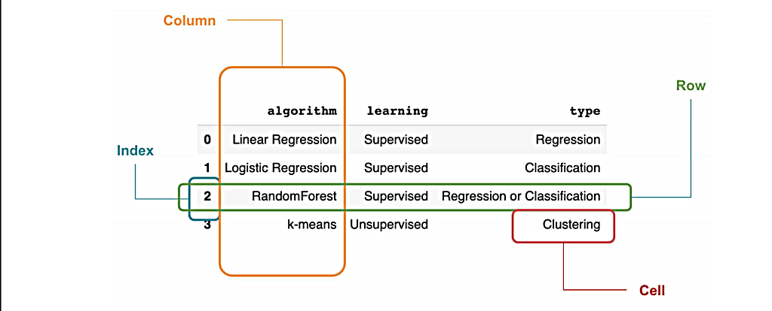
DATAFRAMES & SERIES
Notes:
A Data Frame is a tabular structure that is represented as a two dimensional table
A series is a one dimensional table

Slide 15
DATA EXPLORATION
Data Exploration is an approach used to understand what is in a dataset and characteristics of the dataset
The characteristics include but not limited to size, completeness, correctness, relationships, elements, etcetera

Slide 16
DATA EXPLORATION WITH PANDAS
The data: Sources and types of data
The data format: Flat file
The Python Package used to explore the datasets
Why explore the data?

Slide 17
DATA CLEANING WITH PANDAS
A crucial aspect of data analysis is cleaning data
The intuition is to get the dataset to a form where one can work with it.
The concept of messy data
Missing values, inconsistent data types, nonsensical outliers, malformed records, duplicate values etcetera.

Slide 18
DATA CLEANING OPERATIONS
Data Cleaning operations include but not limited to the following:
Dropping columns
Changing the index of a DataFrame
Renaming columns
Skipping unnecessary rows

Slide 19
EXPLORING NUMPY
Numpy is the fundamental package for scientific computing in Python
Short for Numerical Python, it is a Python library that provides a multidimensional array object.
It provides for fast operations on arrays, including mathematical, logical, shape manipulation, sorting, selecting, etcetera.
Notes:
Link to the Numpy API documentation:
https://numpy.org/doc/stable/reference/index.html

Slide 20
Import numpy as np
Numpy is highly efficient in terms of performance
A Multidimensional array object
Notes:
One of the key features of NumPy is its N-dimensional array object, or ndarray, which is a fast, flexible container for large datasets in Python. Arrays enable you to perform mathematical operations on whole blocks of data using similar syntax to the equivalent operations between scalar elements

Slide 21
NOISY DATA
Noisy data are data with large amount of meaningless information in it called called noise.
Data often contains the ground truth and noise
Data analysis provides an opportunity to filter the noise from the ground truth.
Notes:
https://en.wikipedia.org/wiki/Noisy_data

Slide 22
BIAS
Bias can be taken to mean interference in the outcomes of research by predetermined ideas, prejudice or influence in a certain direction
Bias is any trend or deviation from the truth in data collection, data analysis, interpretation and publication, which can cause false conclusions
Notes:
https://cmotions.nl/en/5-typen-bias-data-analytics/#:~:text=Bias%20is%20taken%20to%20mean,representative%20of%20the%20entire%20population.
https://www.ncbi.nlm.nih.gov/pmc/articles/PMC3900086/

Slide 23
DATA VISUALIZATION
Data visualization is the graphical representation of information and data. By using visual elements like graphs, charts and maps.
Notes:
Reference: https://www.tableau.com/learn/articles/data-visualization#:~:text=Data%20visualization%20is%20the%20graphical,outliers%2C%20and%20patterns%20in%20data

Slide 24
DATA VISUALIZATION LIBRARIES IN PYTHON
Matplotlib: One of most basic libraries for visualizing data graphically. To use, you import the module into the Jupyter Notebook.
Seaborn: This is a library based on Matplotlib. It provides a high-level interface for drawing attractive and informative statistical graphics
Notes:
Reference to the Matplotlib and Seaborn definition: https://towardsdatascience.com/complete-guide-to-data-visualization-with-python-2dd74df12b5e
Link to the Matplotlib documentation: https://matplotlib.org/
Link to the Seaborn documentation: https://seaborn.pydata.org/

Slide 25
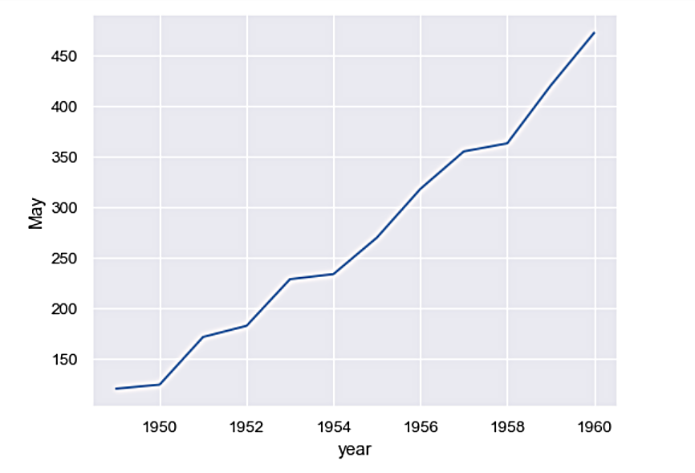
TYPES OF CHARTS AND THEIR INTUITIONS
Line Chart: Relationships between two or more variables

Slide 26
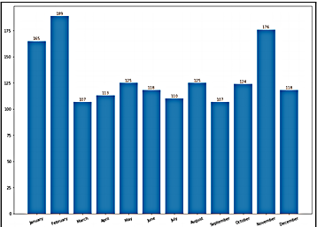
BAR CHART
Bar Chart: Used to distinguish objects between distinct collections.

Slide 27
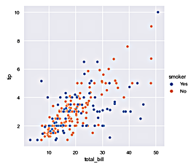
SCATTER PLOT
Scatter Plots: Used to visualize meaningful relationships between variables.

Slide 28
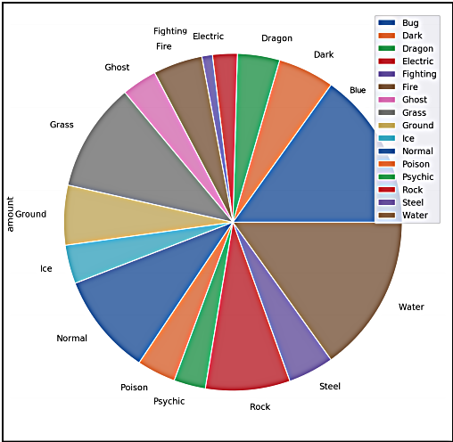
PIE CHART
Pie Chart: Used to communicate proportions

